Slide 1
McHenry County Census Demographics Task Force Findings
October 20, 2015

Slide 2
Task Force Members
Conor Brown Heartland Realtor Organization
Robin Doeden McHenry County Community Foundation
Charlie Eldredge Harvard Economic Development Corporation
Wayne Miczek TranSystems
Sarah Ponitz Senior Care Volunteer Network
Carolyn Schofield McHenry County Board
Rosemary Swierk Direct Steel and Construction

Slide 3
U.S. Census Information- McHenry County
Notes:
The population decline is based on estimate 2014 numbers. The amount of decline is within the margin of error and could sway to a slight decline or slight increase.

Slide 4
Factors of Population Change
Birth Rate
Death Rate
Domestic Migration
International Migration
Notes:
Birth rate factors- lowest number of birth to under 25 years old in decades and higher number of births to women over 40. Creates a gap in number of births.

Slide 5
Chicago Region County Population Changes
Notes:
The entire region is seeing minimal total population changes

Slide 6
Illinois is the only Midwest State losing Population

Slide 7
Why are Illinoisans Leaving
Property Taxes
Employment Opportunities
Business Climate
Weather
Politics
Notes:
Main reasons people stay in Illinois are family and job related. Therefore it makes sense for those migrating out of Illinois to stay within the Midwest region

Slide 8
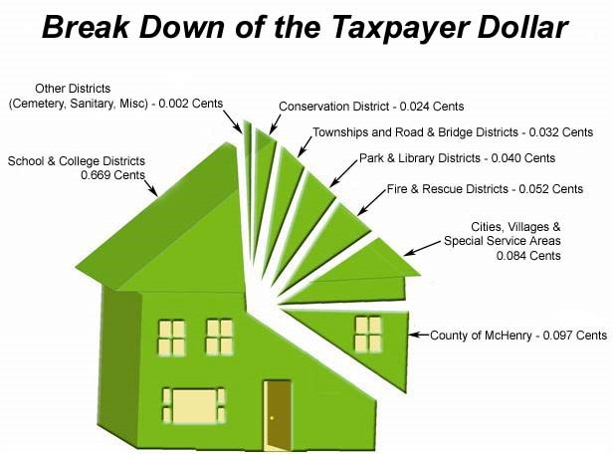

Slide 9
What Can McHenry County Do?
Comprehensive Economic Development Strategy
2030 Comprehensive Plan Revision
Understand the Housing Market
Notes:
A CEDS is a strategy-driven plan for regional economic development. A CEDS is the result of a regionally-owned planning process designed to build capacity and guide the economic prosperity and resiliency of an area or region.

Slide 10
US Census Bureau 63.7% of Americans owned their home in the first quarter of 2015, the lowest since 1993. While the rental vacancy rate fell to 7.1%, the lowest since 1986.
Notes:
Demand for apartments is on the rise.
Sheet from CMAP showing housing stock

Slide 11
Countywide Assessors Office
Move assessments to a centralized County function
Better align assessments with appraisals
Allows for:
Professionalism/specialization
Countywide consistency
Reduces appeals

Slide 12
Aging Population in McHenry County
Fourth fastest growing senior population in Illinois.
The senior population will increase 157% by 2030 (according to Northeastern Illinois Agency on Aging).
As of 2013, there were more than 53,000 seniors (60 and older), which is an 85.2% increase from 2000.
Northeast Illinois’ largest increase in median age from 34.2 to 38 years. Much higher than the national average.
Notes:
Sheet from CMAP

Slide 13
Effects on Emergency Management
Aging Population
Less mobile
Electricity Dependent
Change in ethnic population

Slide 14
Challenges
Addressing the needs of an increasingly diverse population
Finding ways to keep property taxes flat or lower
Engage taxing bodies and residents
Notes:
Providing transportation for elderly and specialized medical care close

Slide 15
Planning for the Future
Need to focus on job creation and economic growth
Attracting and retaining home owners
Efficiencies and customer service
Countywide assessments
Simplify ordinances, fee structure, and permitting
Consolidation or elimination of governmental services

Slide 16
Questions?
Carolyn Schofield
McHenry County Board District 2
815-341-2440
cdschofield@co.mchenry.il.us

